Slide 1
PROVERBS

Slide 2
PROVERBS
He spoke three thousand proverbs, and his songs were one thousand and five.
513 in Proverbs
1 Kings 4.32

Slide 3
PROVERBS
The proverbs of Solomon
LXX ~ paroimia
parable
Hebrew ~ mashal
From the Latin pro (instead of) + verba (words)
Hence, instead of many words

Slide 4
PROVERBS
Job ~
The spirit
Psalms ~
The emotions
Proverbs ~
The mind
The soul
Ecclesiastes ~
The will
Song of Solomon ~
The body

Slide 5
PROVERBS
Song of Solomon ~ young man
Proverbs ~ middle aged
Ecclesiastes ~ old man

Slide 6
PROVERBS
1-22:16 ~ Proverbs of Solomon
22:17-24 ~ Sayings of the wise
25-29 ~ Proverbs of Solomon (collected by Hezekiah's men)
30 ~ Words of Agur
31 ~ Words of King Lemuel
vv. 10-31 ~ Virtuous woman
Outline of Proverbs

Slide 7
PROVERBS
Wisdom ~ hokmah – 45x

Slide 8
PROVERBS
¹³ Who is wise and understanding among you? Let him show by good conduct that his works are done in the meekness of wisdom. ¹⁴ But if you have bitter envy and self-seeking in your
hearts, do not boast and lie against the truth. ¹⁵ This wisdom does not descend from above, but is earthly, sensual, demonic. ¹⁶ For where envy and self-seeking exist, confusion and every evil thing are there. ¹⁷ But the wisdom that is from above is first pure, then peaceable, gentle, willing to yield, full of mercy and good fruits, without partiality and without hypocrisy.
James 3.13-17

Slide 9
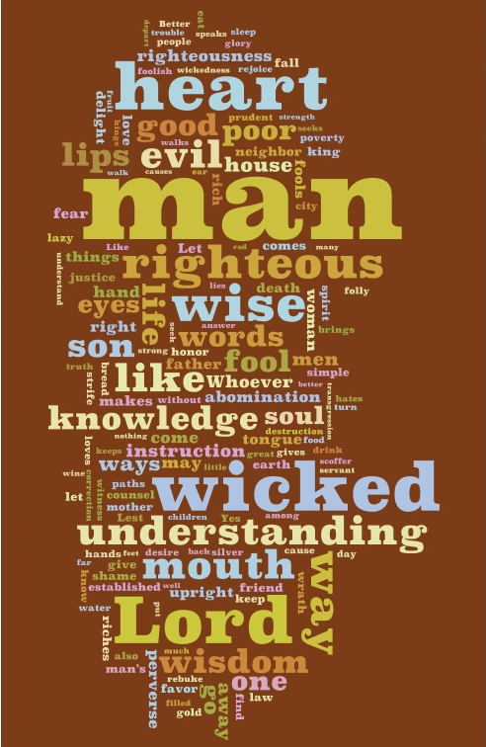
PROVERBS
A Proverbs wordle

Slide 10
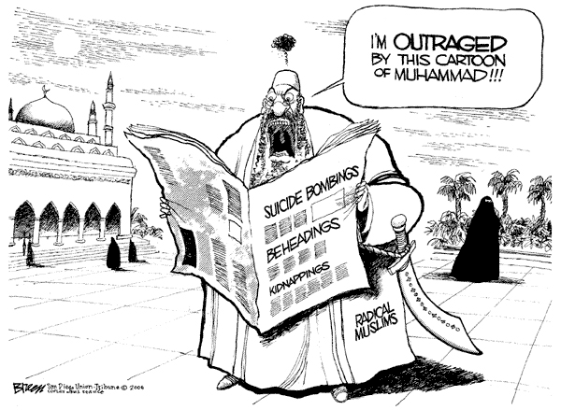
PROVERBS
“Emblematic” parallelism

Slide 11
PROVERBS
Train up ~ chanak – dedication
Literally, according to his way

Slide 12
PROVERBS
"Worldly fear of the Lord is the fear that He might hurt me;
Godly fear of the Lord is the fear that I might hurt Him"
Ray Stedman

